Slide 1
FROM DUST TO STARS
Lesson 13 for March 28, 2020

Slide 2
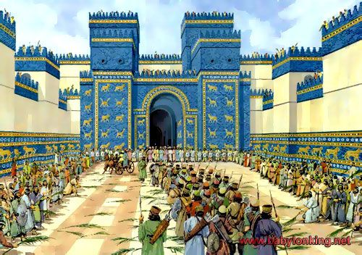
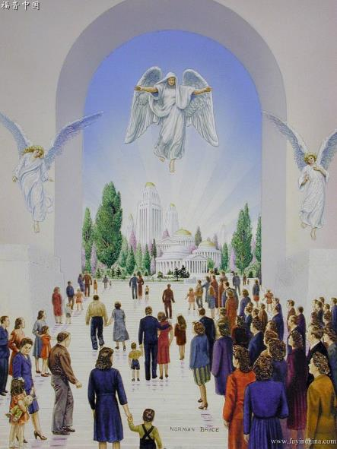
The book of Daniel begins with the king of Babylon defeating Jerusalem and taking God's people captive.
In the last chapter, Michael stands up and defends God's people.
Hard times are coming. However, like Daniel, we’ll also receive our inheritance when the battle ends at the End Time (Daniel 12:13).
The End Time:
Michael stands up. Daniel 12:1
The time of trouble. Daniel 12:1
The resurrection. Daniel 12:2-3, 13
The waiting time:
The sealed time. Daniel 12:4, 8-9
The revealed time. Daniel 12:5-7, 10-12

Slide 3
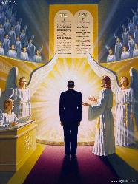
MICHAEL STANDS UP
“At that time Michael shall stand up, the great prince who stands watch over the sons of your people.” (Daniel 12:1)
The psalmist wondered “Who will rise up for me against the evildoers?” (Psalm 94:16). Michael stands up to defend us.
Standing up is many times related to military actions (Ex. 15:7; Dt. 28:7; Jos. 8:3; Jdg. 9:23; 2K. 3:24; 1Chr. 20:23; Psalm 2:2; Is. 14:22; 19:2; Dn. 8:25; 11:2, 14, 40; Mt. 24:7). Michael acts as a military leader who protects His people and leads them, especially during the last stages of the Great Controversy.
The expression is also used in judgement settings (Dt. 19:16; Psalm 1:5; 12:5; 102:13; Is. 28:21; 31:2; Mt. 12:41-42). Michael stands up as a lawyer too. He represents the people of God before the court in Heaven.

Slide 4
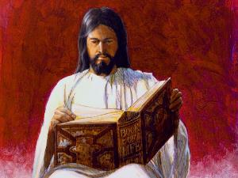
THE TIME OF TROUBLE
“Alas! For that day is great, so that none is like it; and it is the time of Jacob’s trouble, but he shall be saved out of it.” (Jeremiah 30:7)
This time of trouble is not the overall distress before the Second Coming of Jesus (Luke 21:25), but a distress that will affect only the people of God. They’ll wonder if theirs sins have actually been forgiven.
This time of trouble will begin after grace ends and God takes His Spirit away from Earth (Revelation 22:11), as the first plagues are poured down.
Everyone “who is found written in the book” will be delivered. Which book?
This is undoubtedly the Book of Life (Philippians 4:3, Revelation 3:5; 20:5). Everyone who has accepted Jesus will remain written in this book if they don’t apostatize. We’re saved by faith in Jesus!

Slide 5
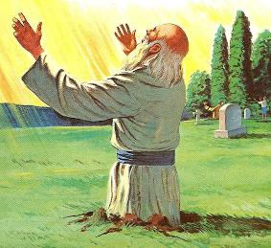
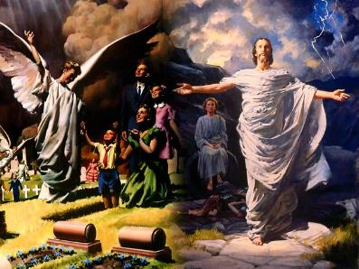
THE RESURRECTION
“And many of those who sleep in the dust of the earth shall awake, some to everlasting life, some to shame and everlasting contempt.” (Daniel 12:2)
There are two references to the resurrection (v. 2 and 13). This means that eternal life will be given to us in that moment, not when we die. We’ll sleep in death from the moment we die until the resurrection.
We cannot do or think about nothing while we’re dead (Ecclesiastes 9:5, 10). Not even praising God (Psalm 115:17).
However, death is already defeated. Jesus overcame death with His resurrection. Jesus will resurrect the saints, then “He will swallow up death forever” (Isaiah 25:8).
The important thing is whether we’ll be resurrected to life or to death. It’s a decision we must make today, while there’s still time and hope.

Slide 6
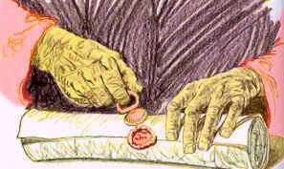
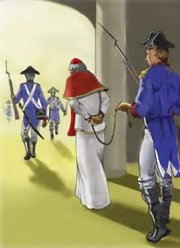
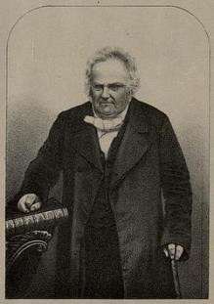
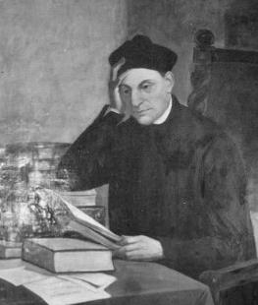
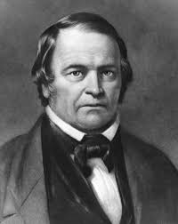
THE SEALED TIME
“But you, Daniel, shut up the words, and seal the book until the time of the end; many shall run to and fro, and knowledge shall increase.” (Daniel 12:4)
Unlike Revelation, Daniel is a sealed book (Revelation 22:10). Nevertheless, the seal will be broken at a specific moment, then the book will be fully understood. That moment is the End Time.
When does the End Time begin? As we studied in Daniel 11:40, the French Revolution and the imprisonment of the Pope by the Napoleonic army (1798 AD) indicate the beginning of the End Time.
From that moment, numerous expositors in England, Joseph Wolff in the Middle East, Manuel Lacunza in South America, and William Miller in the United States, together with a host of other students of the prophecies, declared, on the basis of their study of the prophecies of Daniel, that the second advent was at hand.
Joseph Wolff
Manuel Lacunza
William Miller

Slide 7
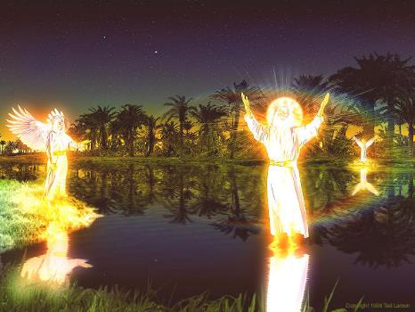
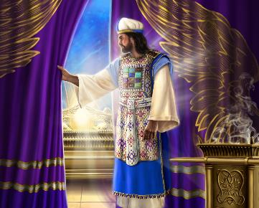
THE REVEALED TIME
“Blessed is he who waits, and comes to the one thousand three hundred and thirty-five days.” (Daniel 12:12)
After Gabriel finished his exposition, an angel asked Jesus (the man clothe in linen): How long shall the fulfillment of these wonders be?” (v. 6). Jesus swore that the end would come after a period of 1,260 years (3 and a half times).
Daniel requested a detailed explanation (v. 8), so two prophetic times were given to him: 1,290 and 1,335 years.
1,335
508
538
1798
1843
1,260
1,290
Pray that you’ll be one of the many who will be purified, made white and refined (v. 10)
508: Clovis gets baptized
538: Justinian gives the Pope political power
1843: Millerism

Slide 8
E.G.W. (Education, cp. 19, p. 178)
“The history which the great I AM has marked out in His word, uniting link after link in the prophetic chain, from eternity in the past to eternity in the future, tells us where we are today in the procession of the ages, and what may be expected in the time to come. All that prophecy has foretold as coming to pass, until the present time, has been traced on the pages of history, and we may be assured that all which is yet to come will be fulfilled in its order.”

